Slide 1
INTRODUCTION TO MACHINE LEARNING
Raj K Baliyar Singh
Asst. Professor, Dept. CSE

Slide 2
LOGISTIC REGRESSION

Slide 3

Classification is the process of categorizing a given set of data into classes.

Slide 4
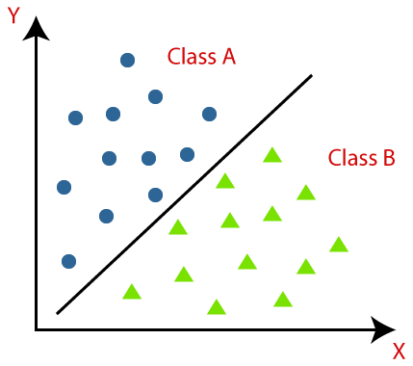

Slide 5
Logistic Regression is basically a predictive model analysis technique where the target variables (output) are discrete values for a given set of features or input (X).
It uses binary classification. It predicts the probability of occurrence of a binary outcome using a logit function.
binomial: target variable can have only 2 possible types: “0” or “1” which may represent “win” vs “loss”, “pass” vs “fail”, “dead” vs “alive”, etc.
multinomial: target variable can have 3 or more possible types which are not ordered(i.e. types have no quantitative significance) like “disease A” vs “disease B” vs “disease C”.
ordinal: it deals with target variables with ordered categories. For example, a test score can be categorized as: “very poor”, “poor”, “good”, and “very good”. Here, each category can be given a score like 0, 1, 2, or 3.

Slide 6
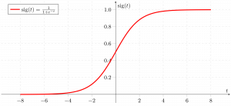
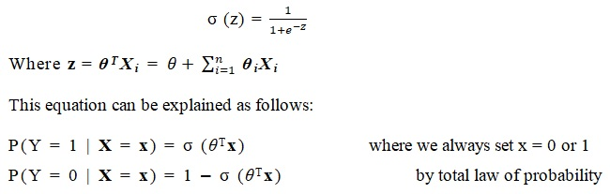
Logistic regression is an algorithm used in statistics and machine learning.
The logistic regression model specifies the probability of a binary output y_{i} ϵ {0, 1} given the input X_{i}.
The sigmoid function is applied to the linear regression to achieve the prediction of the y value on the given set of X values.
P(Y | X , θ) = f = σ(z)
σ(z) is a sigmoid or logit function and that is

Slide 7
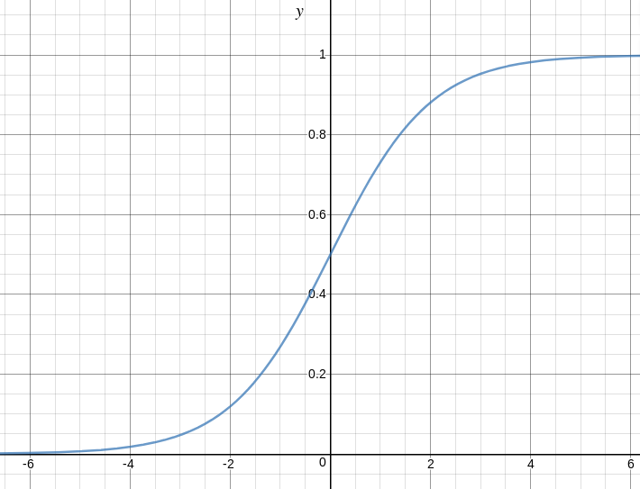
tends towards 1 as z\right arrow\infty
tends towards 0 as z\right arrow-\infty
is always bounded between 0 and 1

Slide 8
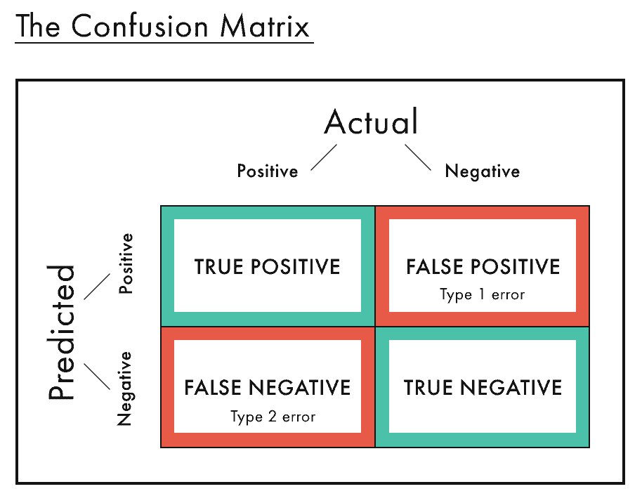
Confusion Matrix in Machine Learning
The confusion matrix is used to evaluate the performance of machine learning.
The general idea is to count the number of times instances of class A are classified as class B.
Each row in a confusion matrix represents an actual class, while each column represents a predicted class.

Slide 9
Precision precision = (TP) / (TP+FP) TP is the number of true positives
FP is the number of false positives
A trivial way to have perfect precision is to make one single positive prediction and ensure it is correct (precision = 1/1 = 100%). This would not be very useful since the classifier would ignore all but one positive instance.
Recall recall = (TP) / (TP+FN)

Slide 10
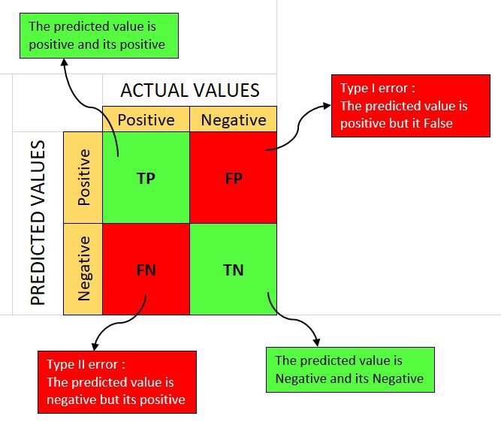
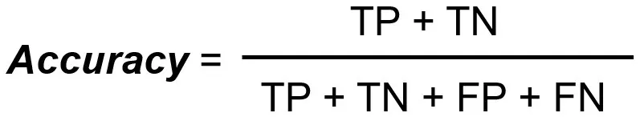

It is difficult to compare two models with low precision and high recall or vice versa. So to make them comparable, we use F-Score. F-score helps to measure Recall and Precision at the same time. It uses Harmonic Mean

Slide 11
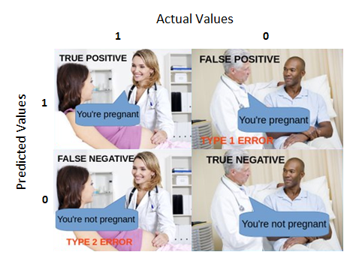
True Positive:
Interpretation: You predicted positive and it’s true.
You predicted that a woman is pregnant and she actually is.
True Negative:
Interpretation: You predicted negative and it’s true.
You predicted that a man is not pregnant and he actually is not.
False Positive: (Type 1 Error)
Interpretation: You predicted positive and it’s false.
You predicted that a man is pregnant but he actually is not.
False Negative: (Type 2 Error)
Interpretation: You predicted negative and it’s false.
You predicted that a woman is not pregnant but she actually is.

